Slide 1
PROBLEM SOLVING

Slide 2
Introduction
A computer is a very powerful and versatile machine capable of performing a multitude of different tasks, yet it has no intelligence or thinking power.
The intelligence Quotient (I.Q) of a computer is zero.
A computer performs many tasks exactly in the same manner as it is told to do.
This places responsibility on the user to instruct the computer in a correct and precise manner, so that the machine is able to perform the required job in a proper way.
A wrong or ambiguous instruction may sometimes prove disastrous. Garbage in garbage out

Slide 3
Introduction..
In order to instruct a computer correctly, the user must have clear understanding of the problem to be solved.
A part from this he should be able to develop a method, in the form of series of sequential steps, to solve it.
Once the problem is well-defined and a method of solving it is developed, then instructing the computer to solve the problem becomes relatively easier task

Slide 4
Introduction…
Thus, before attempt to write a computer program to solve a given problem.
It is necessary to formulate or define the problem in a precise manner.
Once the problem is defined, the steps required to solve it, must be stated clearly in the required order.

Slide 5
Procedure (Steps Involved in Problem Solving)
A computer cannot solve a problem on its own.
One has to provide step by step solutions of the problem to the computer.
In fact, the task of problem solving is not that of the computer.
It is the programmer who has to write down the solution to the problem in terms of simple operations which the computer can understand and execute.

Slide 6
Procedure (Steps Involved in Problem Solving)..
In order to solve a problem by the computer, one has to pass though certain stages or steps. They are: -
1. Understanding the problem
2. Analyzing the problem
3. Developing the solution
4. Coding and implementation.
5.Testing

Slide 7
Procedure (Steps Involved in Problem Solving)..
Understanding the problem
Here we try to understand the problem to be solved in totally.
Before moving to the next stage or step, we should be absolutely sure about the objectives of the given problem.

Slide 8
Procedure (Steps Involved in Problem Solving)..
Analyzing the problem:
After understanding thoroughly the problem to be solved, we look different ways of solving the problem and evaluate each of these methods.
The idea here is to search an appropriate solution to the problem under consideration.
The end result of this stage is a broad overview of the sequence of operations that are to be carries out to solve the given problem.

Slide 9
Procedure (Steps Involved in Problem Solving)..
Analyzing the problem:
To help in analysis, the problem has to be broken into : -
            Inputs
            Outputs
            Process
            Here a tool called IPO chart is used

Slide 10
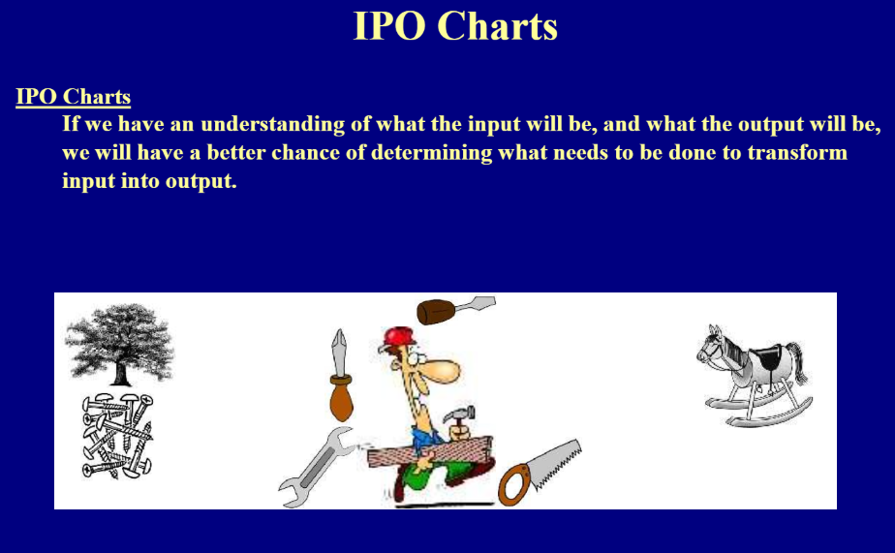
IPO Charts

Slide 11
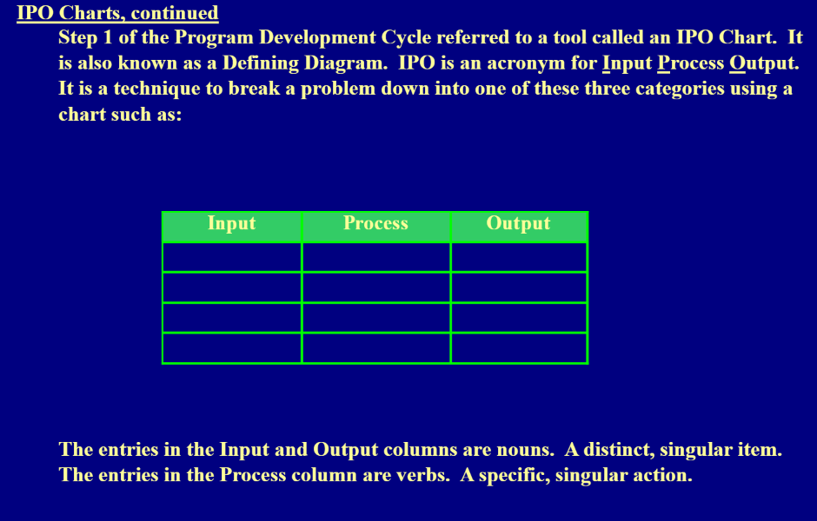
Ipo CHARTS…

Slide 12
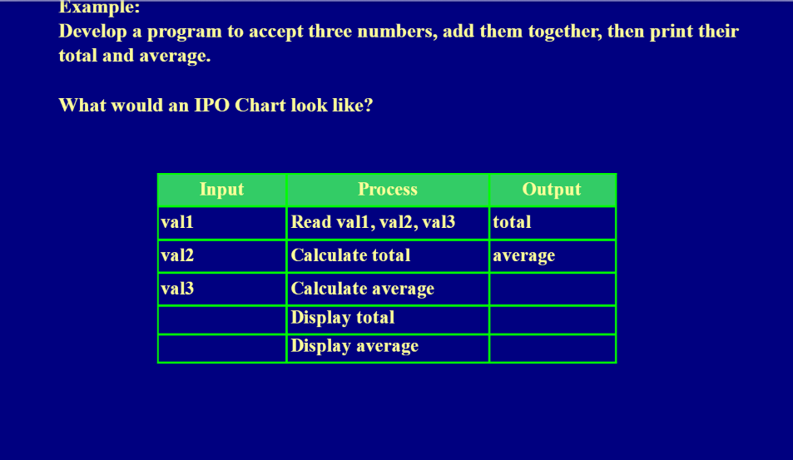
IPO CHARTS ….

Slide 13
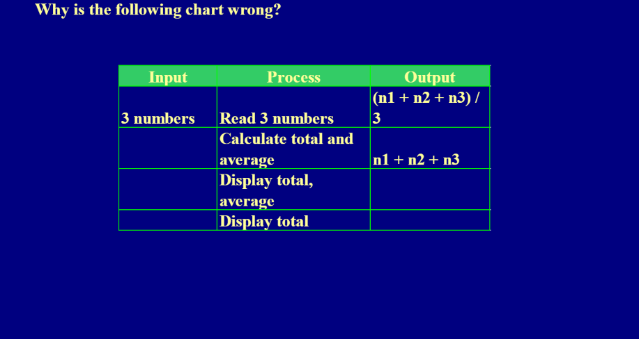
IPO CHARTS….

Slide 14
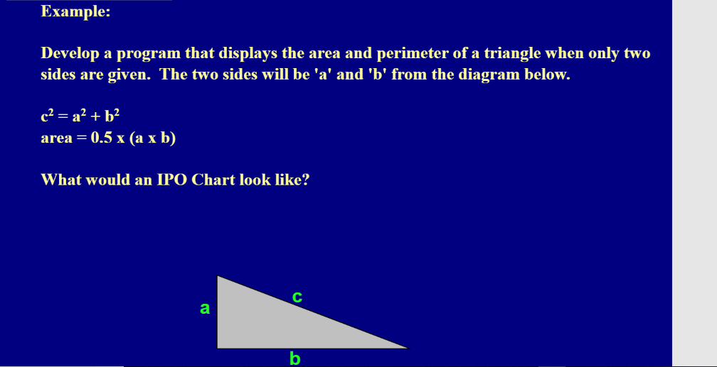
IPO CHARTS

Slide 15
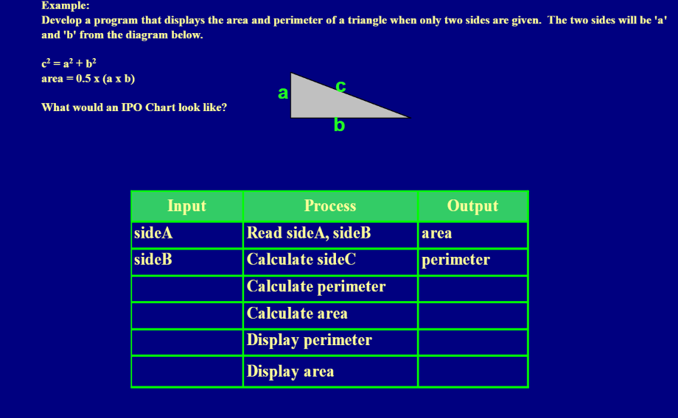
Ipo charts ….

Slide 16
IPO charts… (Examples)
QN1.Create a program which will accept the ages of four boys and calculate their total age and average age. The program must display both the total age and the average age
QN 2.Create a program which will accept the length and width of a rectangle and display the area.
QN 3. Create a program which will accept the number of hours worked by an employee as well as the rate at which he is to be paid. It will then calculate the wages due. The program will then display the hours worked, the wages rate and the wages owed to the employee.

Slide 17
IPO charts… (Examples)
Using IPO chart to analyze the given problem
From the given IPO charts, produce Pseudocode and Flow charts
Identify all variables used in IPO chart and their data types

Slide 18
Procedure (Steps Involved in Problem Solving)..
Developing the solution:
Here the overview of the sequence of operations that was the result of analysis stage is expanded to form a detailed step by step solution to the problem under consideration.
In this stage the programmer needs to simulate a program using PSEUDOCODE and Flow charts.
Pseudocode looks like program code but IT IS NOT PROGRAM CODE.

Slide 19
Procedure (Steps Involved in Problem Solving)..
Coding and implementation: (Next Semester)
The last stage of the problem solving is the conversion of the detailed sequence of operations in to a language that the computer can understand.
Here each step is converted to its equivalent instruction or instructions in the computer language that has been chosen for the implantation.

Slide 20
Procedure (Steps Involved in Problem Solving)..
TESTING (Next Semester)
In this stage the programmer has to check if the developed solution meets the user expectation or not
Here we need to check if there is an error(s) that leads to incorrect output
(logical errors, syntax errors and semantic errors)

Slide 21
Assignment
Using IPO chart to analyze the following problems
From the given IPO charts, produce Pseudocode and Flow charts
Identify all variables used in IPO chart and their data types

Slide 22
Assignment
Create a program which will accept the distance travelled by a car and the time it took to reach its destination and calculate the (average) speed at which it travelled. {Note that speed = distance over time}.
Create a program which will accept the amount of money paid on a product as well as the price. It will then calculate the balance owed to the store. It will then display the amount paid, the original price and the balance
Create a program which will accept the length, width and depth of a rectangular pool and display the volume of water it can hold.
Create a program which will accept the number of days worked and calculate the number of weeks. The program must then show the number of days and the number of weeks calculated.

Slide 23
END

